Slide 1

2019

Slide 2
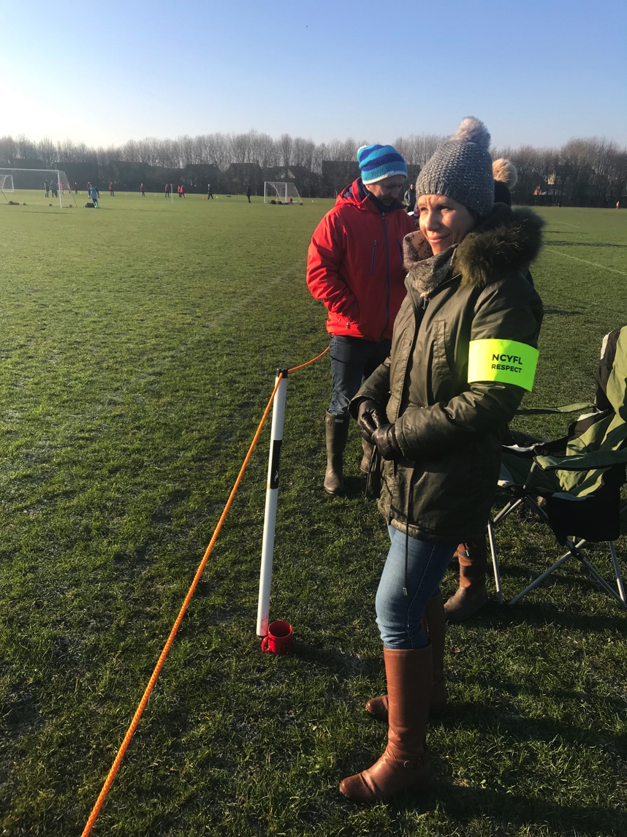
How do we keep referees?
We need referees for our games. We need referees to return for the next game. We need referees to return the next season. We need your help to keep the referees and build to cover every game.
We would like a RESPECT parent on each team for each game who can help us keep the referees in our games.
We need to respect the referees. Allow for learning during the game just as the players on the field.
We need your support with all of your teams and your parents on the sidelines.

Slide 3

Partnership with Score for Referees

Slide 4
Legion FC

Slide 5

Getting into schools
After-school programs
Teaching physical education classes
Before school engagement
Bridge gap from school to field
Changing Lifestyle

Slide 6
2019 Annual Awards

Slide 7
Boys Recreational Coach of the Year
Billy Brown

Slide 8
Girls Recreational Coach of the Year
Nicholas Mulligan

Slide 9
Boys competitive Coach of the Year
Oleg Sinelnikov

Slide 10
Girls competitive Coach of the Year
Eric Faison

Slide 11
Volunteer of the Year
Eddy Nalley

Slide 12
Volunteer of the Year
Douglas Walk

Slide 13
Referee of the Year
Joshua Lane

Slide 14
Adult League volunteer of the Year
Ben Cherry

Slide 15
Administrator of the Year
Madeleine Hannah

Slide 16
Commitment to the Game
Ken Headley

